Slide 1
Human Brain and Artificial Neural Networks

Slide 2
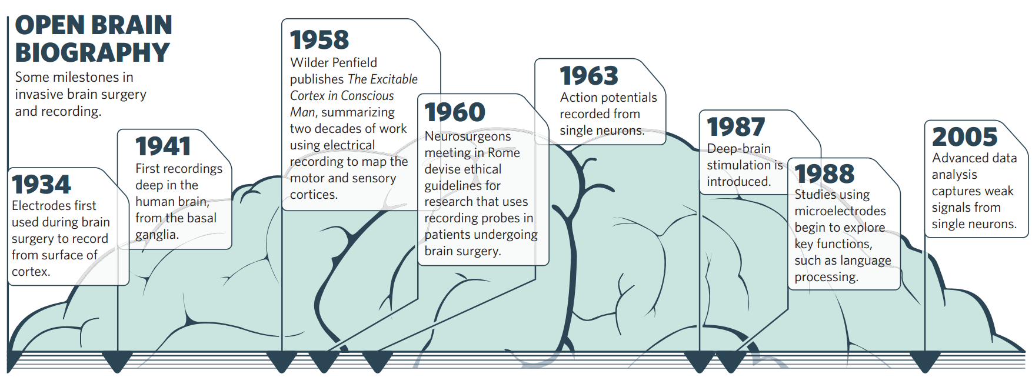
Probing timeline

Slide 3
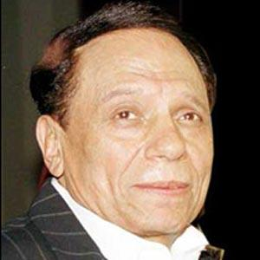

Slide 4
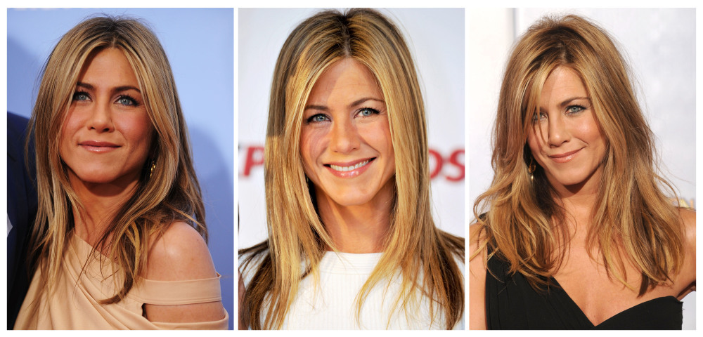

Slide 5
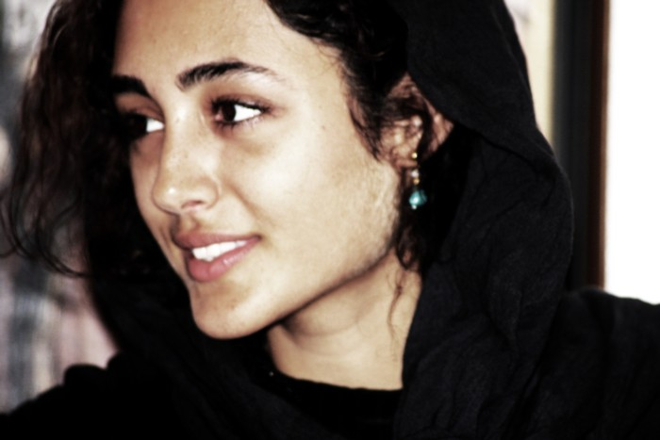

Slide 6
